Slide 1
Yammertime TOASTMASTERS
Elections for 2022-2023 Club Officers
April 06, 2022 | PRESENTED BY: Charissa Yang, Yammertime Toastmasters
Notes:
Good morning! Toastmasters Club OFFICER elections are coming up so I wanted to review some of how that works today… [15s]

Slide 2
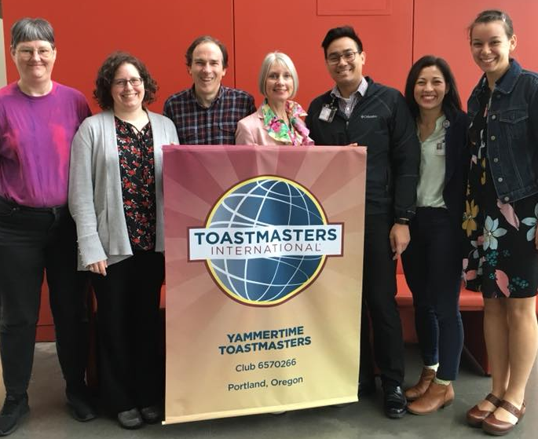
Overview
1. What are the officer roles?
2. Why do we need officers?
3. Timeline
4. Questions?
Notes:
The topics I’ll cover include: What officer roles are required, Why clubs need officers, The timeline for elections, and Then we’ll have some open time for questions.

Slide 3
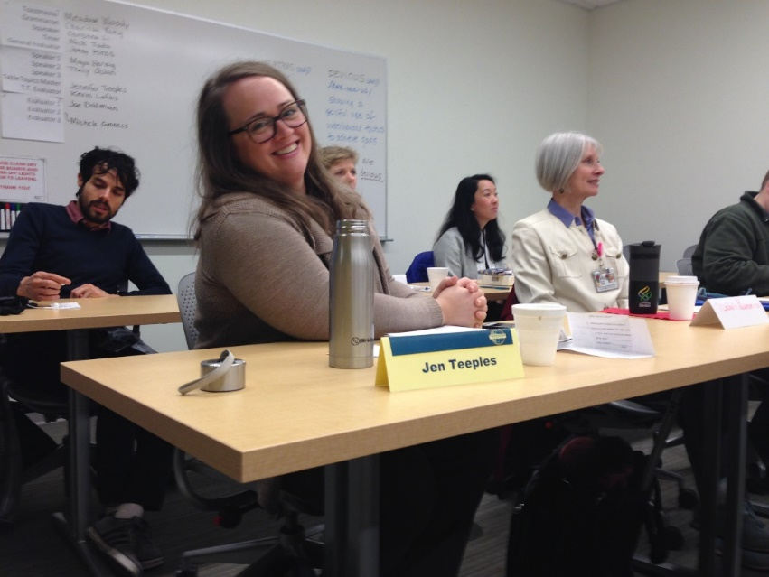
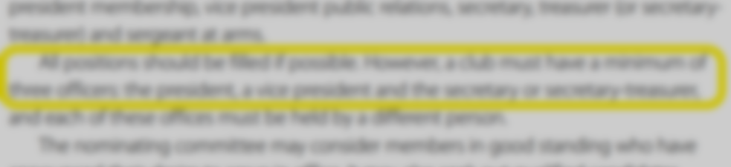
What are the Officer Roles?
Elected Officers:
President
Vice Presidents (minimum 1):
Education (VPE)
Membership (VPM)
Public Relations (VPPR)
Secretary
Treasurer
Sergeant at Arms (SAA)
Ex officio (not elected):
Immediate Past President
At least 3 required. Up to 8 officers can serve.
2021 Club Leadership Handbook, p 53
Notes:
There are 8 club officer roles that are recognized by Toastmasters International. I put it this way because it’s possible for clubs to have more than 8 officers, but, WHQ will only recognize 1 person serving in each of the 8 official roles. (However if 2 people were interested in the same role, they could each take credit for 6 months out of the year, while actually working together all year, cooperatively.) Probably more often the opposite occurs and many clubs have fewer than 8 individuals serving as officers. In effect, the roles can be consolidated or combined so that fewer people are covering the various tasks. The minimum required is only 3 individuals serving as officers, in which different individuals must serve in the roles of President, a VP role and Secretary.

Slide 4
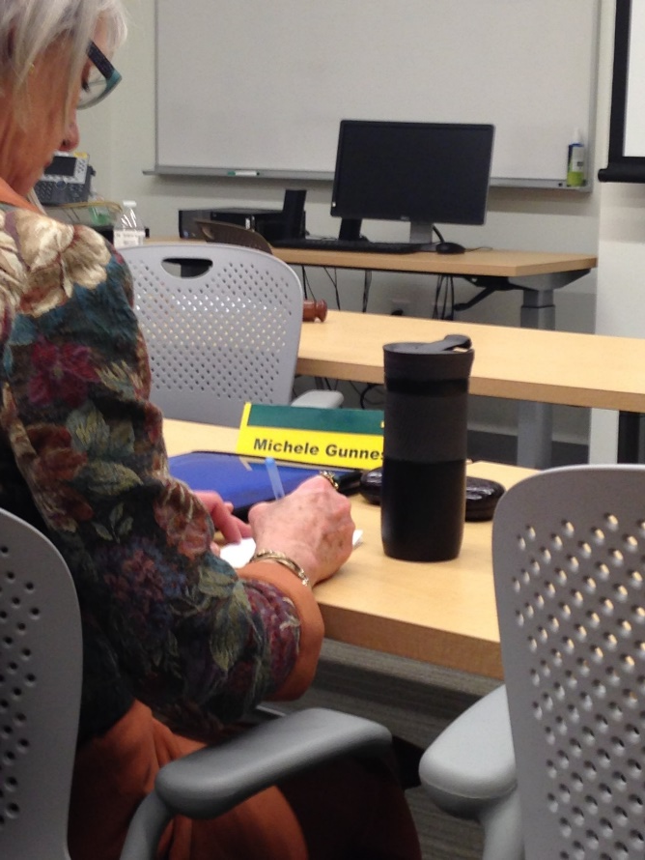
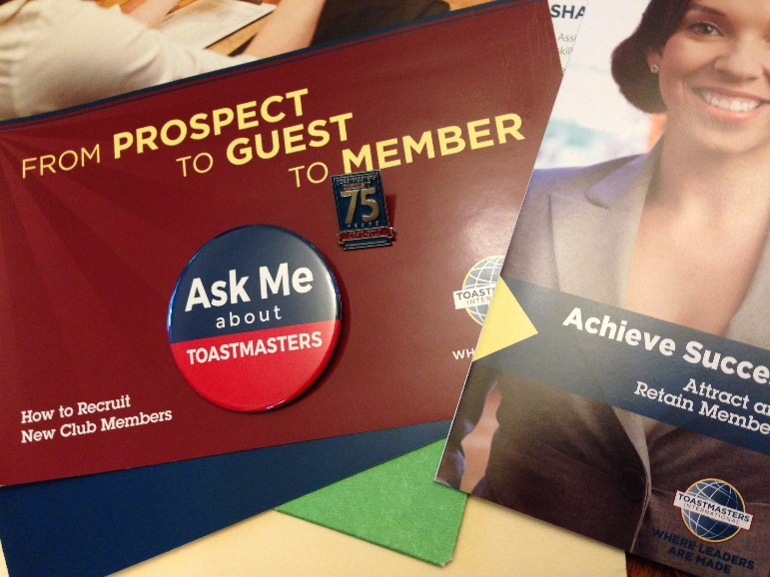
What do Officers do?
Officers are essential!
Sustain our membership
Ensure quality meetings
Notes:
Officers are essential. I didn’t always appreciate why, but without officers, we wouldn’t have any organized publicity, organized onboarding of new members, or organized weekly meeting agendas. Toastmasters has a really good structure that makes sense and works, but we still need folks willing to take the lead for these ongoing activities. It works best when we have a team that communicates and cooperates well. And it’s fun and exciting when we start to see progress.

Slide 5
Timeline
Nominations and Elections
Wed 4/6 Nominating Committee appointed
Wed 4/20 Nominating Committee Report due (2 weeks before election)
Wed 4/27 Candidates announced (1 week before election)
Wed 5/04 Election
During May: Officers-elect may shadow officers to learn roles.
Fri/Sat 6/3-6/4 District Training (Officers must attend, all welcome)
There is a second District Training after 6 months, too.
2021 Club Leadership Handbook, p 53
Notes:
A club does not have to have a nominating committee, but if it does, there are specifics put out by World HQ: It includes 3 people, the IPP and 2 others appointed by the Club President. Because Elections are to be the first meeting in May (WHQ), the appointment of the nominating committee needs to happen in early April (now!) so that there’s time for the nominating committee to consider and communicate and discuss who might serve, in order to propose a slate of officers for the membership to vote on.

Slide 6
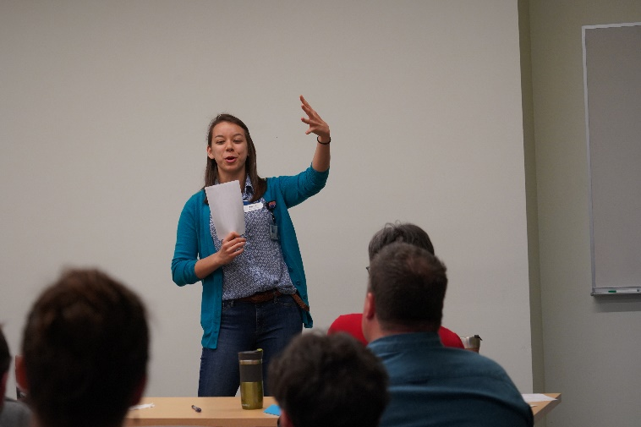
Requirements
Nominees:
Current active member
Officers:
Lead by example:
Remain an active member
Participate in District “TLI” Club Officer Training
Set and achieve goals to help club
Participate in Officer meetings:
Communicate
Collaborate
2021 Club Leadership Handbook, p 53

Slide 7
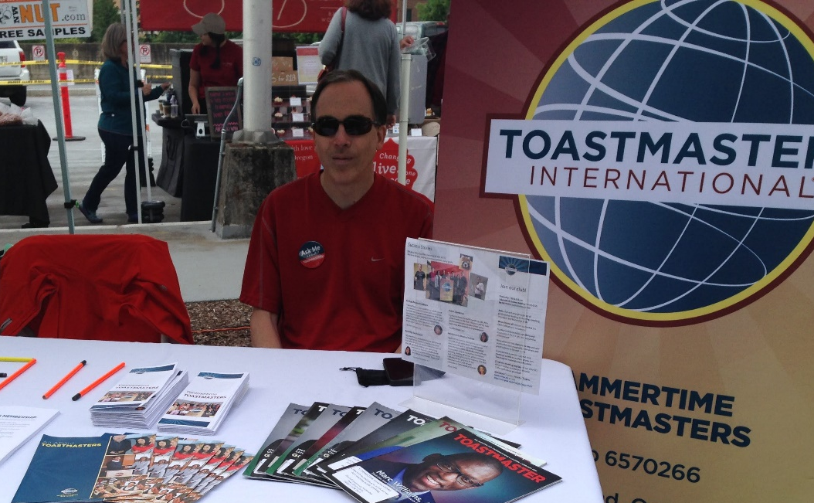
Questions…?
Members, please ask anything!
Officers (current and past):
What attracted you to your role?
How did the role evolve?
What surprised you about the role?
What did you find challenging?
What makes one a good fit for the role?
What do you wish you did differently?

Slide 8
Questions…?
Members, please ask anything!
Officers (current and past):
What attracted you to your role?
How did the role evolve?
What surprised you about the role?
What did you find challenging?
What makes one a good fit for the role?
What do you wish you did differently?
Notes:
Thank you. I hope you will be prepared to talk to member of the nominating committee soon, as we will need to reach out to all members once or twice to hopefully make this a collaborative process.

