Slide 1
Visionary Communications 3: Develop a Communication Plan
YouTube – Easy and Useful
February 2, 2023 | PRESENTED BY: Charissa Yang, PR Masters Toastmasters Club #7898167
Notes:
You have probably watched videos on YouTube, right? Who here has watched something on YouTube? [Raise hand.] Whether to learn something, to find entertainment, get news, looks like everyone has been on YouTube. But. Have you ever thought of creating a YouTube channel yourself…?

Slide 2
YouTube – Easy and Useful
Overview
Why you might want YouTube
What are set up steps
How to upload videos to YouTube
Top tips from Charissa
Notes:
I’m going to talk about why you might want your own YouTube channel,
What are the set up steps…
How to Get started uploading videos to YouTube.
My top tips….
And how you can learn more.

Slide 3
YouTube – Easy and Useful
Why would I want a YouTube Channel?
Store your own videos
Share speeches/presentations
Save others’ videos to make them easy to find later
Embed videos in websites
Notes:
1. Store your own videos. We’re all in Toastmasters. So… are all giving speeches…. Watching videos of yourself is an invaluable way to help you improve your speaking skills – putting them on YouTube is a great convenience.
2. To share speeches/presentations. You made a great speech – wouldn’t it be great to have it recorded? Then you can share it with more people, someone who couldn’t make your live presentation. Or someone who did but wants to review it. And you can keep it – maybe to promote yourself – to show your boss – or to help you get a job?
3. Aside from using YouTube for your own videos, you might want to Save others’ videos that you discover on YouTube, if you want to make them easy to find later. You just create a playlist.
4. To make it easy to embed your videos on websites. I’ve helped many organizations set up YouTube channels not because they wanted a YouTube channel at all, but because they wanted to post their videos to their website. There are other ways to do it, but embedding videos on YouTube makes for the easiest way to include videos on a webpage.

Slide 4
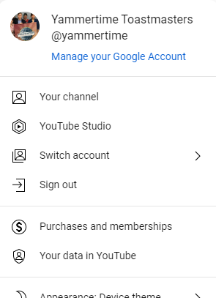
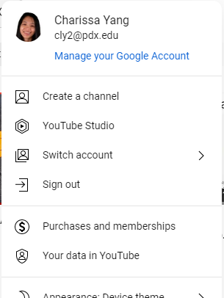
YouTube – Easy and Useful
What is a YouTube Channel?
Gmail = Google = YouTube.
In Gmail (or any Google app)
» Apps Launcher (open menu)
» YouTube (launch it)
In YouTube
» Account menu (profile pic, top right)
» Your Channel (or Create a channel)
  If Creating a channel:
  Confirm Handle
  Verify (just once, later is fine)
Notes:
A Google Account is a YouTube account! Do you have a Google or Gmail account (even if it’s not your main email account)? Did you know that google owns YouTube? If you have a google or gmail account, you have a YouTube account already because they are linked.

Slide 5
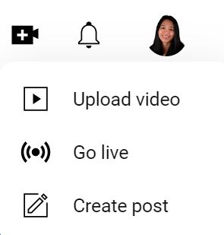
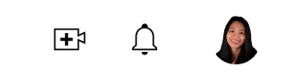
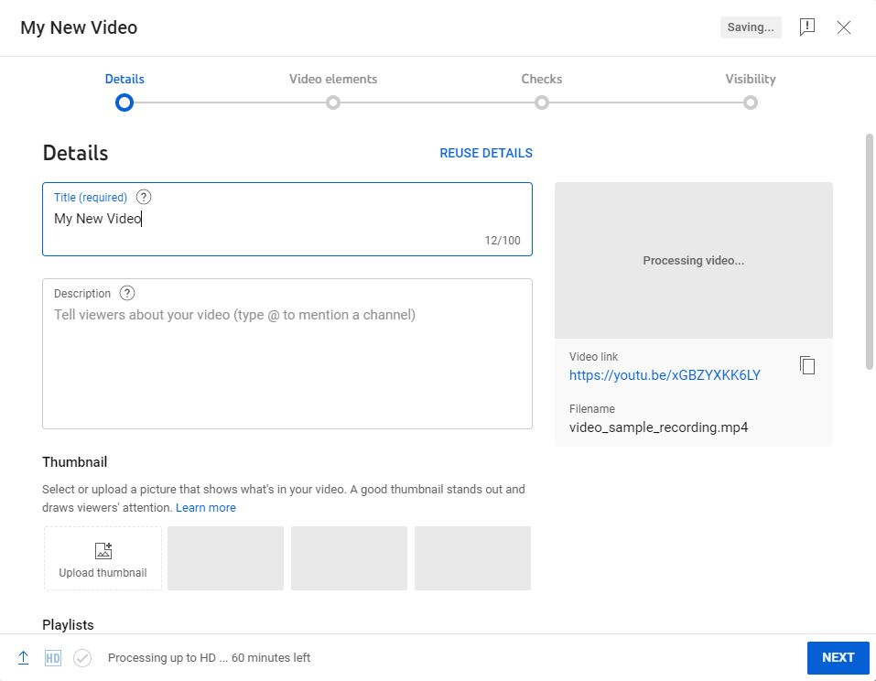
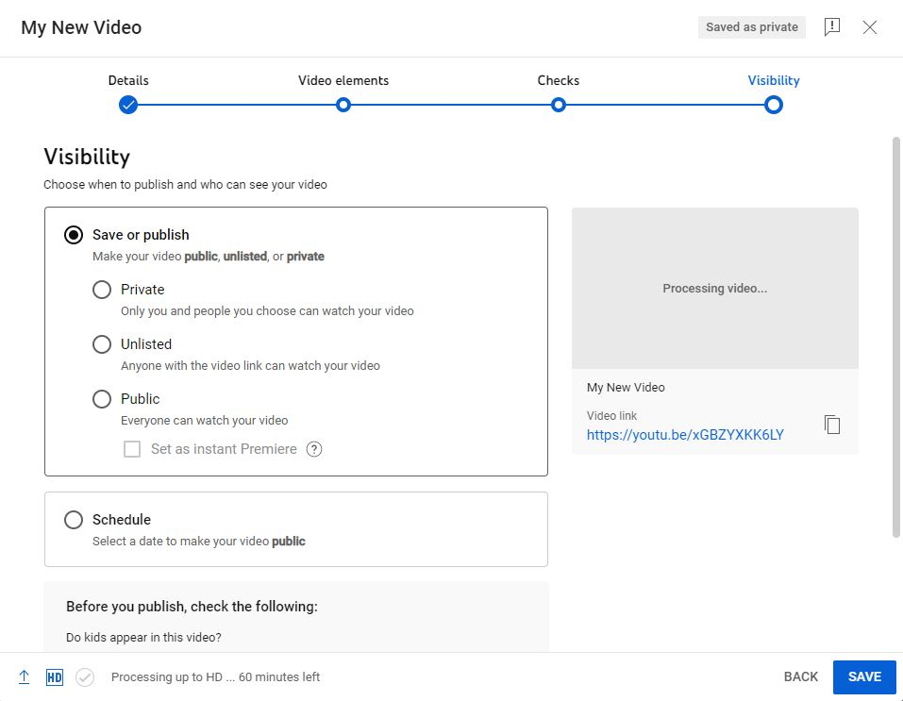
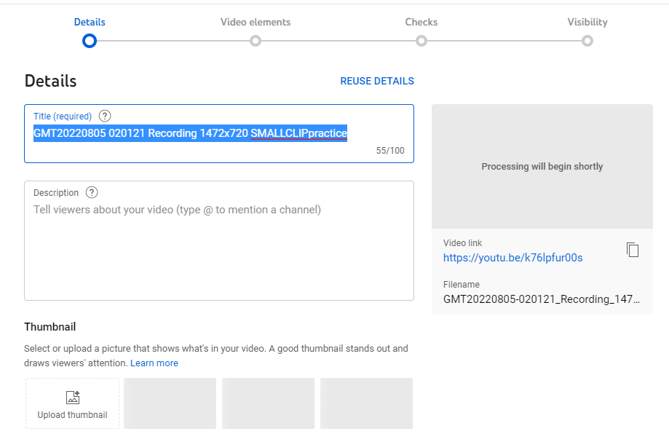
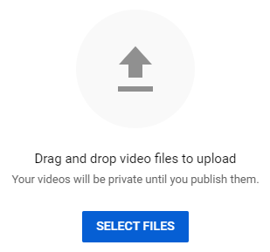
YouTube – Easy and Useful
How do I upload videos?
Click (top right)
Upload Video
Drag and drop (or Select Files)
Wait. As you wait for upload:
Details, Video Elements: anytime
Visibility: Set immediately!

Slide 6
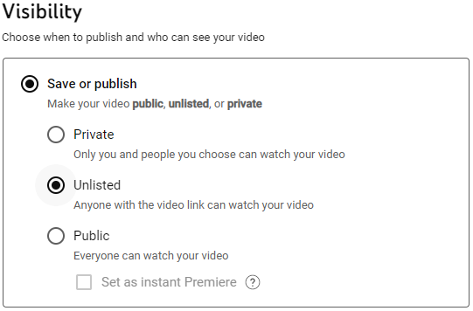

YouTube – Easy and Useful
Tip 1: Visibility Privacy settings
Private – Invitation only.
Unlisted – Anyone who has link. Not findable by searching.
Public – Findable by searching; anyone online can watch.
Notes:
Your video’s Visibility is the one item that you should set intentionally, and as soon as possible - when you’re uploading the video. All the other details you might defer, as you can edit them later. But if your Visibility’s default setting is Public, and you didn’t correct it, AND your video needs edits or approval before it goes live, that can be a disaster. Similarly, if you video is already approved and need to launch ASAP, if it’s set to Private by mistake, that can also be a problem.

Slide 7
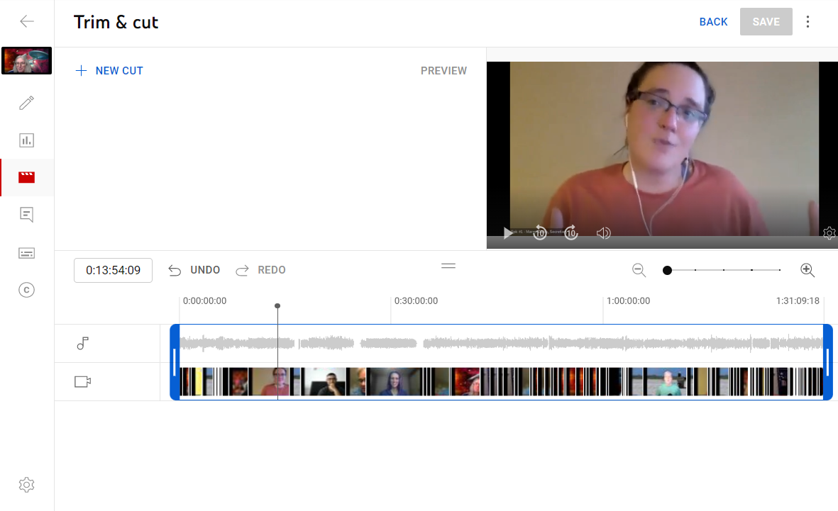
YouTube – Easy and Useful
Tip 2: Trim Video use YouTube Editor
YouTube’s Editor trims video.
Easy and precise.
Post-processing can be slow. But it’s totally worth it overall.

Slide 8
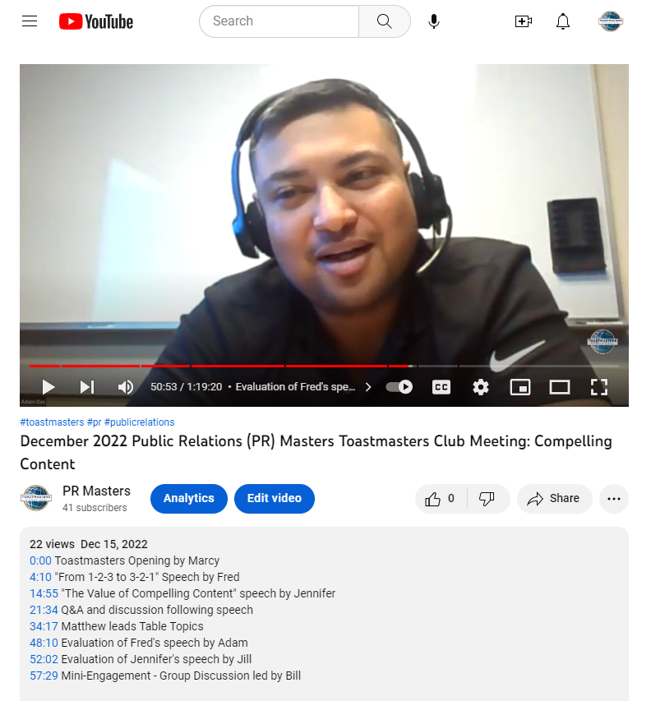
YouTube – Easy and Useful
Tip 3: Chapters are a great (amazing) feature for very little effort
Video descriptions can include timestamps
Timestamps create Chapters automatically, if start with 0:00.
Chapters enhance navigation and create automatic previews.

Slide 9
YouTube – Easy and Useful
Wrapping up
Handout includes more tips
Easy to get started
Go for it. Change is good!

Slide 10
YouTube – Easy and Useful
Wrapping up
YouTube is useful!
Easy to get started
Learn more:
  Ask me!
  See my handout
  Come see my longer speech tomorrow 2/2 at PR Masters
Go for it.

