Slide 1
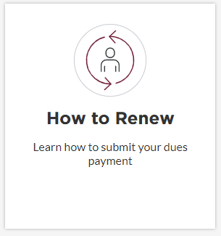
YAMMERTIME TOASTMASTERS TREASURER ANNOUNCEMENTS — 4/26/2023
1 | Can renew now for the next cycle. April (now) can pay for Oct-Mar Oct - can pay for April-Sep
2 | Can renew yourself—anyone can! Login at toastmasters.org Scroll down to How to Renew
3 | Dues increase to $60 in August. Set by World HQ Pay now and it’s still just $45
Notes:
Really nice, b/c Used to be 30, then 60 d. Beneficial b/c some folks can get reimbursed through work, and can submit either more timely or fewer invoices for reimbursement. Some just like paying fewer times a year, too. So always offer the option as treasurer, always ask as a member.

